Slide 1
IBM Cloud Pak for Applications v4.1 —

Slide 2

Cloud accelerates digital transformation
Innovate Faster - Deliver true business value and delight your customer
Transform Business – Refresh legacy and employ the cloud to deliver a competitive advantage
Optimize ROI - Increase operational efficiency and reduce cost
2

Slide 3
What’s preventing rapid Modernization today?
Skills
Microservices, containers/Kubernetes, open source, using Cloud based services
“What code changes need to be made?”
Effort to change, affinities with current execution environment
Enterprise grade requirements
Security, compliance, data movement, scaling, integration, management, analytics, “day 2 operations” in a hybrid Cloud environment
3

Slide 4
Application development is changing the face of business
App & Services Development and Deployment
new tools/platforms
Rapid productivity growth
Optimizing business process efficiency
New abilities to leverage important business data
Keeping pace with the demands of a connected world
more developers
agile methods
accelerating digital innovation volume and pace
4

Slide 5

Cloud Paks: Middleware Anywhere
A faster, more secure way to move your core business applications to any cloud
through enterprise-ready containerized software solutions
Complete yet simple Application, data and AI services, fully modular and easy to consume
IBM certified Full software stack support, and ongoing security, compliance and version compatibility
Run anywhere On-premises, on private and public clouds, and in pre-integrated systems
IBM containerized software
Packaged with Open Source components, pre-integrated with the common operational services, and secure by design
Container platform and operational services Logging, monitoring, security, identity access management
AWS
Microsoft Azure
Google Cloud

Slide 6


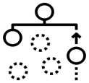













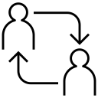








Cloud Paks – Pre-integrated for cloud use cases
Today, IBM offers clients the first six Cloud Paks…
Cloud Pak for Applications
Cloud Pak for
Data
Cloud Pak for Integration
Cloud Pak for Automation
Cloud Pak for Multicloud Management
Cloud Pak for Security
Developer & DevOps Tools
Modernization
Toolkit
Organize
Analyze
API Lifecycle
Messaging
and Events
Content
Operational
Intelligence
Multicluster
App and Infrastructure
Federated
Search and Investigation
Incident Response
Frameworks and Runtimes
Collect
App and Data Integration
Workflow and Decisions
Security and Compliance Management
Security Orchestration and Automation
Container platform and operational services
Container platform and operational services
Container platform and operational services
Container platform and operational services
Container platform and operational services
Container platform and operational services
AWS
Microsoft Azure
Google Cloud
IBM Cloud
Edge
Private
Systems
6

Slide 7

Foundation – Hybrid multicloud
Build once.
Deploy anywhere.
Innovate anywhere.
with anyone’s technology.
Move freely.
optimize for cost savings.
Hybrid multicloud platform
Capabilities
Application | Data | Integration | Management | Automation | Security
Foundation
Linux | Containers | Common Services | Multi-cluster Management
Infrastructure
IBM public cloud
AWS
Azure
Google Cloud
Edge
Private
Systems
OpenShift Kubernetes platform for portability
Choice of more cloud vendors and infrastructure
Deployable as untethered private cloud, on premises
Support for multiple open standards across hybrid
Virtualization to bridge legacy to the cloud
Common services for consistency and compliance
IBM Cloud / August 2019 / © 2019 IBM Corporation
Notes:
The foundation of the IBM hybrid multicloud platform is an infrastructure-independent common operating environment that runs virtually anywhere—from essentially any data center to multiple clouds to the edge. It lets you select the best architecture and approach to address the most critical application, data and workload requirements of your business. The foundation consists of Red Hat Enterprise Linux to build virtually anywhere, and Red Hat OpenShift for application, workload and data portability.

Slide 8



Cloud Pak for Applications
Migrate to cloud at your own rate and pace with flexible licensing to mix and match your entitlements over time
Run existing apps
Protects customer investments: Continue to run existing apps – WebSphere, JBoss
Modernize existing apps
Refactor existing applications to containers on OpenShift
.
Build new apps
Develop and deploy new cloud native applications

Slide 9
Cloud Pak for Applications – Strategic Value
The ultimate flexibility across open source, platform, runtimes, and tools all in 1 place!
Build new cloud-native apps on the broadest range of supported runtimes - ultimate choice
OpenShift Container Platform 4.2 for hybrid multi-cloud - ultimate portability
“Right-size” and modernize between the various WAS editions - ultimate flexibility
Empower teams to start quickly with increased productivity and enterprise governance - ultimate control
Run existing apps
Accelerators for Teams
Derived from Kabanero.io open source
Ultimate open source stack for all workload needs
WebSphere Portfolio
Modernize existing apps
Red Hat Runtimes
Build new apps
Red Hat OpenShift Container Platform
The only Pak with no functional restrictions

Slide 10

Cloud Pak for Applications: what you need today, what you need tomorrow
Run existing apps
Build new cloud-native apps
WebSphere Application Server
WebSphere ND | WebSphere Base
Liberty Core | Mobile Foundation
JBoss Enterprise Application Server
WebSphere Application Server
WebSphere ND | WebSphere Base
Liberty Core | Mobile Foundation
JBoss Enterprise Application Platform
ACCELERATORS FOR TEAMS & ENTERPRISE GOVERNANCE
Equipping teams with content, tools, architectures and methods so they can focus on business problems from day 1
Red Hat CodeReady Workspaces
Collaborative OpenShift-native IDE
Red Hat Runtimes
WebSphere
Java/Jakarta EE
Open Liberty, JBoss EAP
Java SE
OpenJDK
Java Web
JBoss WS
Traditional
WebSphere
Modernize existing apps
IBM Modernization & Developer Tools
Included with all components
Transformation Advisor
WebSphere Migration Toolkit
Enterprise Dev tools & extensions for local IDE’s
Supported when used with Cloud Pak for Applications, no charge
Javascript
Node.js
Spring
Spring Boot
Serverless
Cloud Functions
IBM Modernization & Developer Tools
Included with all components
Transformation Advisor
Application Navigator
WebSphere Migration Toolkit
Enterprise Dev tools & extensions for local IDE’s
Supported when used with Cloud Pak for Applications, no charge
Liberty
MicroProfile
Open Liberty , Thorntail
Reactive
Vert.x
Java.next*
Quarkus
*coming soon
Distributed Data
Data Grid
Messaging
AMQ Broker
Mobile Foundation
SECURITY
SSO
Red Hat OpenShift Container Platform
Perpetual and Term licensing options available w/ no functional restrictions to OpenShift
*coming soon

Slide 11




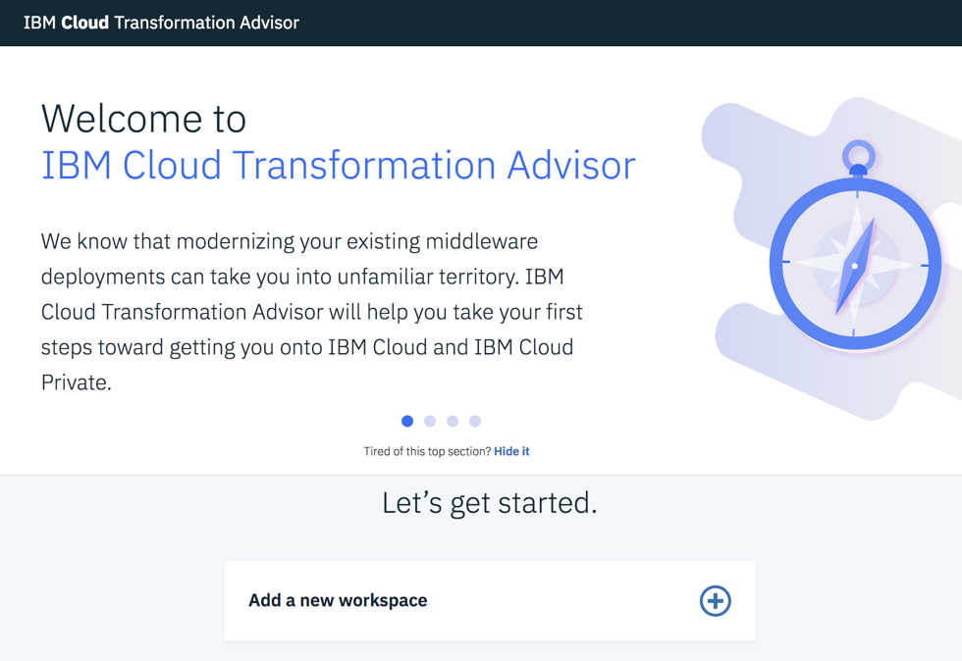

Introspects traditional WebSphere, IBM MQ, WebLogic and Tomcat deployments and determines complexity of modernization
Included in IBM Cloud Private, IBM Cloud Pak for Apps, WebSphere 9.0.5.0, and in stand-alone Docker containers
Modernize existing apps
IBM Cloud Transformation Advisor
Quickly evaluate on-premises Java EE applications and messaging infrastructure to accelerate deployment to private or public cloud
Oracle WebLogic
Provides recommendations, detailed reports, artifacts and automates deployment for simple application modernization
http://ibm.biz/CloudTA
Analysis Report
Potential issues, severity, possible solutions and estimate of resolution effort
Technology Report
Details on IBM platform support for technologies used in the app
Inventory Report
High-level inventory of application content and structure
Customized application configuration and deployment files

Slide 12








kabanero.io
Part of Enterprise Runtimes and Accelerators for Teams
A modern microservices-based framework that simplifies development, build, and continuous deploy of apps for Kubernetes and Knative
100% Open Source
Runtimes in
pre-built containers
Integrated
Developer Tools
Integrated
DevOps Toolchain
Open source runtimes and frameworks optimized for cloud-native
Simplify building cloud-native apps in containers for Kubernetes and Knative
Automated end-to-end toolchain from code check-in to production Kubernetes deploy
✔
Single control point for lifecycle of runtimes and apps at scale
✔
Extensions to industry standard IDEs
Pre-built Tekton tasks & pipelines for build and deploy, customizable
✔
✔
Customize to meet company policies and technology choices
✔
Templates and developer focused CLI
Integrates with Git
✔
✔
Pre-built Kubernetes deployments using Kubernetes operators
Leverages the power of K8s to manage your toolchain
✔
Spring boot
iter8
K8s-sigs/
application
Appsody
Hosted
© 2019 IBM Corporation
12
12

Slide 13

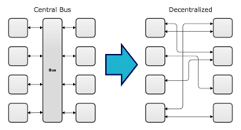

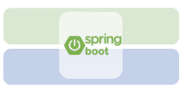
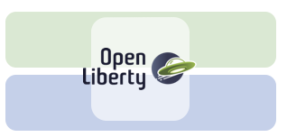

Innovate with Confidence The unique value of Accelerators for Teams derived from kabanero.io
Jane: Lead Enterprise Developer
Jane rapidly builds and deploys microservices
…
Champ: Solution Architect
Platform and Regulatory Standards
Champ provides (customized) pre-configured application stacks
OS, Java and AppServer/JavaEE versions and maintenance
Authentication, Security, Logging, Monitoring
Empowering teams to start quicker: IT Ops and Architects are now able to provide curated, pre-configured development and runtime stacks to the LOB team. Empowers teams to start quicker.
Operational Efficiency: Maintenance, security controls, and compliance can be returned to the IT Ops teams with updates dynamically pushed to the environments used by the LOB teams.

Slide 14

IBM Mobile Foundation
A Platform for Modernizing and Developing Multi-channel Digital Apps
Rapid
Intelligent
Engaging
Trustworthy
Multi-Channel
Release new apps and app versions more quickly
Simple for developers to incorporate AI and ML, creating powerful and insightful apps
Engage users by providing personalized app experience
Develop apps with security, governance and industry leading privacy standards
Deploy apps across multiple channels at the highest level of production performance
Digital App Builder for building apps rapidly
Reduce time to build new applications or modernize current apps
Release new apps and app versions more quickly
Secure CoreML model distribution without app updates
Watson connectors
Digital app studio (training)
A/B testing (Live update)
Controlled feature release
Push
In app feedback
Personalization
Multi step authentication
Encrypted offline JSON Store
AppID integration
Credential isolation
Certificate pinning
HIPAA Ready
Multi Channel Analytics
Multi Channel Notifications
Encrypted offline storage
Proven scalability for millions of devices

Slide 15
®
https://www.ibm.com/legal/us/en/copytrade.shtml

